Slide 1
Laminar Premixed Flames and Diffusion Flames

Slide 2
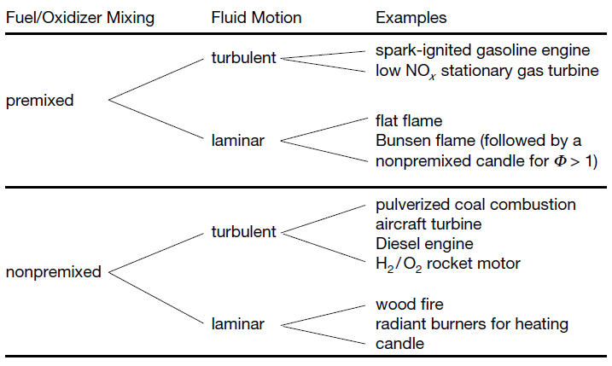
Basic Types of Flames

Slide 3
COMBUSTION MODES AND FLAME TYPES
Combustion can occur in flame mode
Premixed flames
Diffusion (non-premixed) flames
Combustion can occur in non-flame mode

Slide 4
What is a flame?
A flame is a self-sustaining propagation of a localized combustion zone at subsonic velocities
Flame must be localized: flame occupies only a small portion of combustible mixture at any one time (in contrast to a reaction which occurs uniformly throughout a vessel)
A discrete combustion wave that travels subsonically is called a deflagration
Combustion waves may be also travel at supersonic velocities, called detonations
Fundamental propagation mechanism is different in deflagrations and detonations
Laminar vs. Turbulent Flames: both have same type of physical process and many turbulent flame theories are based on an underlying laminar flame structure

Slide 5
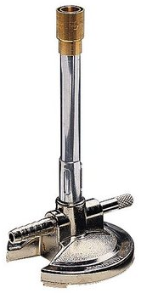
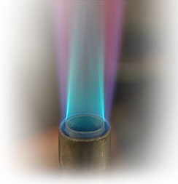
LAMINAR PREMIXED FLAMES
Fuel and oxidizer mixed at molecular level prior to occurrence of any significant chemical reaction
Air
Fuel

Slide 6
DIFFUSION FLAMES
Reactants are initially separated, and reaction occurs only at interface between fuel and oxidizer (mixing and reaction taking place)
Diffusion applies strictly to molecular diffusion of chemical species
In turbulent diffusion flames, turbulent convection mixes fuel and air macroscopically, then molecular mixing completes the process so that chemical reactions can take place

Slide 7
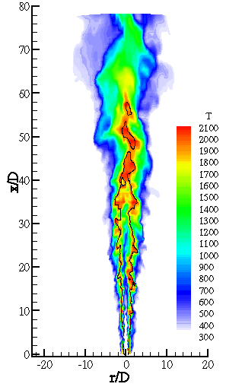
Full range of φ
throughout
reaction zone

Slide 8
LOOK AGAIN AT BUNSEN BURNER
Secondary diffusion flame
results when CO and H
products from rich inner flame
encounter ambient air
Fuel-rich pre-mixed
inner flame

Slide 9
What determines shape of flame? (velocity profile, flame speed, heat loss to tube wall)
Under what conditions will flame remain stationary? (flame speed must equal speed of normal component of unburned gas at each location)
What factors influence laminar flame speed and flame thickness (φ, T, P, fuel type)
How to characterize blowoff and flashback
Most practical devices (Diesel-engine combustion) has premixed and diffusion burning

Slide 10
PRINCIPAL CHARACTERISTICS OF LAMINAR PREMIXED FLAMES
Definition of flame speed, S_{L}
Temperature profile through flame
Product density is less than the reactant density so that by continuity the velocity of the burned gases is greater than the velocity of the unburned gases
For a typical hydrocarbon-air flame at atmospheric pressure, the density ratio is about 7

Slide 11
Convenient to divide the flame into two zones
Preheat zone: little heat is released
Reaction zone: most of the chemical energy is released
2.a Thin region of fast chemistry
Destruction of fuel molecules and creation of intermediate species
Dominated by bimolecular reactions
At atmospheric pressure, fast zone is usually less than 1 mm
Temperature and species concentration gradients are very large
The large gradients provide the driving forces for the flame to be self-sustaining, i.e. diffusion of heat and radical species from the reaction zone to the preheat zone
2.b Wider region of slow chemistry
Chemistry is dominated by three-body radical recombination reactions, such as the final burn-out of CO via
CO + OH → CO₂ + H
At atmospheric pressure, this zone may extend several mm

Slide 12
LAMINAR FLAME STRUCTURE
Laminar flame structure. Temperature and heat-release rate profiles based on experiments of Friedman and Burke Reference: Turns An Introduction to Combustion

Slide 13
EXAMPLE: FLAT FLAME BURNERS
Adiabatic flat-flame burner
Flame is stabilized over bundle
of small tubes through which fuel-air
mixture passes laminarly
Stable only over small range of conditions
Non-adiabatic flat-flame burner
Utilizes a water-cooled face that allows
heat to be extracted from the flame,
which in turn decreases SL
Stable over relatively wide
range of conditions

Slide 14
EXAMPLE: FLAME SHAPE
A premixed laminar flame is stabilized in a 1-D gas flow where the vertical velocity of the unburned mixture, Vu, varies linearly with the horizontal coordinate, x, as shown in figure
Determine the flame shape and the distribution of the local angle of the flame surface from the vertical.
Assume the flame speed is independent of position and equal to 0.4 m/s, which is a nominal value for a φ=1 CH₄-Air flame

Slide 15
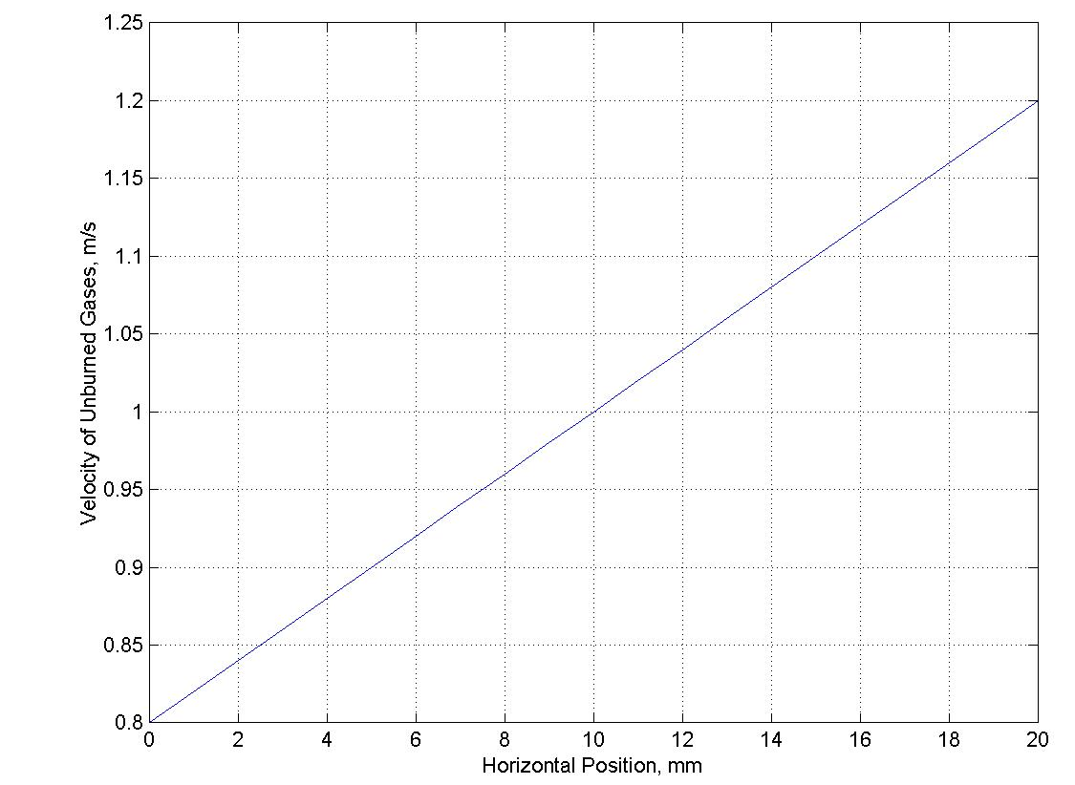

Slide 16
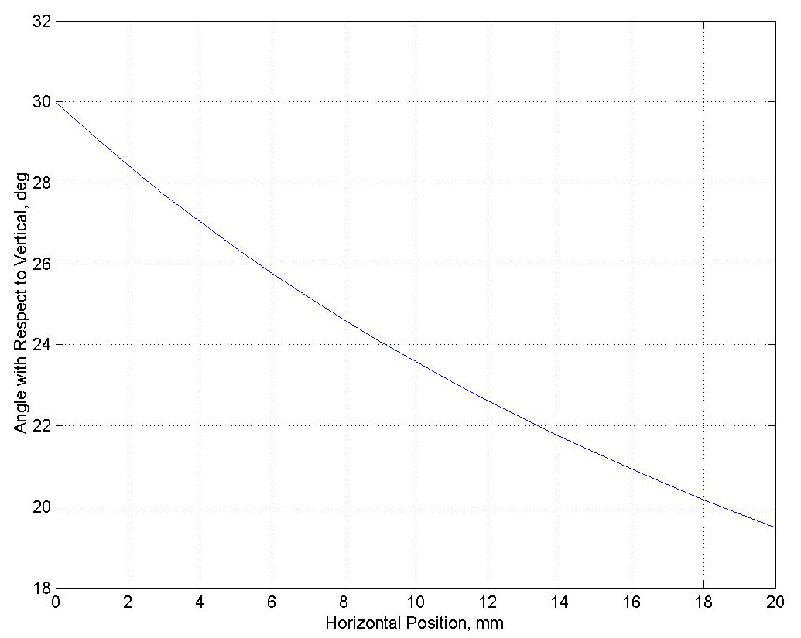
RESULTS

Slide 17
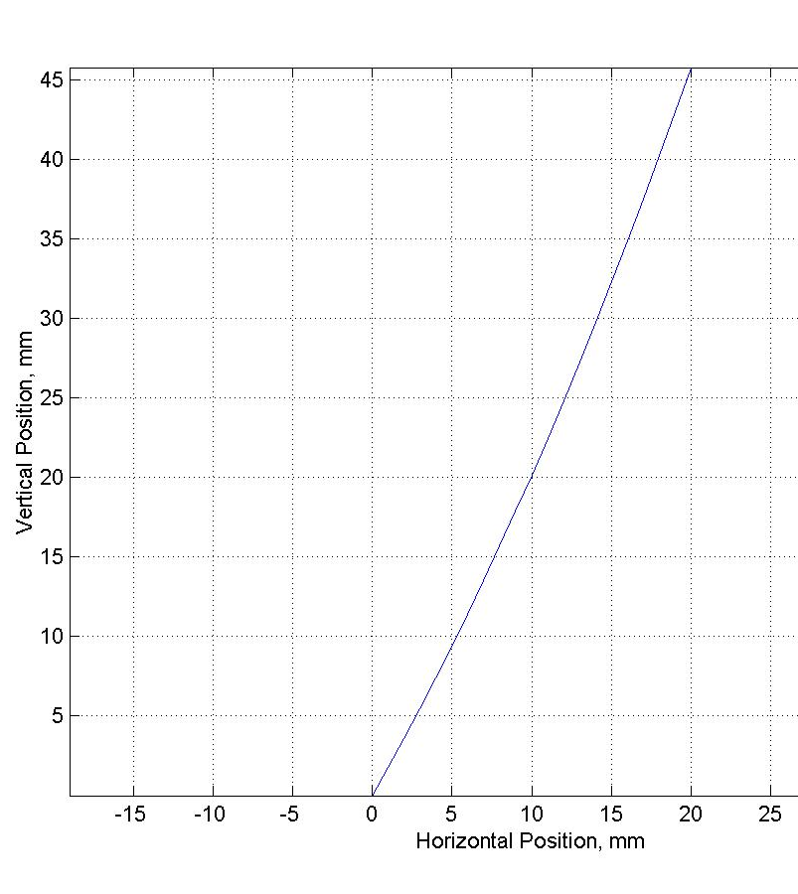

Slide 18
LAMINAR PREMIXED FLAMES: SIMPLIFIED ANALYSIS
Analysis couples principles of heat transfer, mass transfer, chemical kinetics, and thermodynamics to understand the factors governing:
Flame speed, S_{L}
Flame thickness, δ (ANSWER, δ=2α/S_{L})
Simplified approach using conservation relations

Slide 19
Assumptions:
1-D, constant area, steady flow
Neglect: kinetic and potential energy, viscous shear work, thermal radiation
Constant pressure (neglect small pressure difference across flame)
Diffusion of heat governed by Fourier’s law
Diffusion of mass governed by Fick’s law (binary diffusion)
Lewis number (Le≡α/D) unity
Individual specific heats are equal and constant
Fuel and oxidizer form products in a single-step exothermic reaction
Oxidizer is present in stoichiometric or excess proportions; thus, the fuel is completely consumed at the flame.

Slide 20
MASS TRANSFER AND FICK’S LAW OF DIFFUSION
Mass transfer and heat conduction in gases governed by similar physics at molecular level
Mass transfer can occur by molecular processes (collisions) and/or turbulent processes
Molecular processes are relatively slow and operate on small spatial scales
Turbulent processes depend upon velocity and size of an eddy (or current) carrying transported material

Slide 21
Fick’s Law of Diffusion
Mass flow of species A
per unit area
(perpendicular to the flow)
Mass flow of species A
associated with molecular
diffusion per unit area
D_{AB}: Binary diffusivity and
is a property of the mixture
Mass flow of species A
associated with bulk flow
per unit area

Slide 22
SPECIES CONSERVATION
Rate of increase of = Mass of A into CV – Mass of A out of CV + Rate of mass production by Chem. R
mass of A within CV
Divide by AΔx and take limit as Δx → 0
Steady-flow, 1-D form of species conservation
for a binary gas mixture, assuming species
diffusion only occurs as a result of
concentration gradients

